Slide 1

HIGH-Paw
“Welcome to High-Paw, where Dog Meets World! A full stack web application where owners can create doggie playdates. Using a third party mapping API a user can add a pin to the map to create a new hangout. Once created other user are able to view and/or join the hangout.

Slide 2
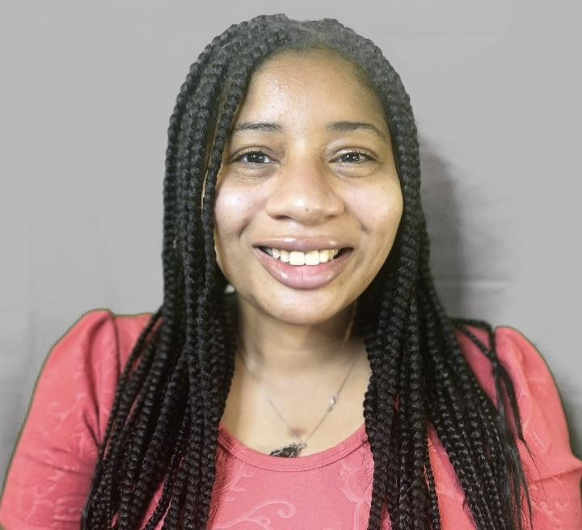

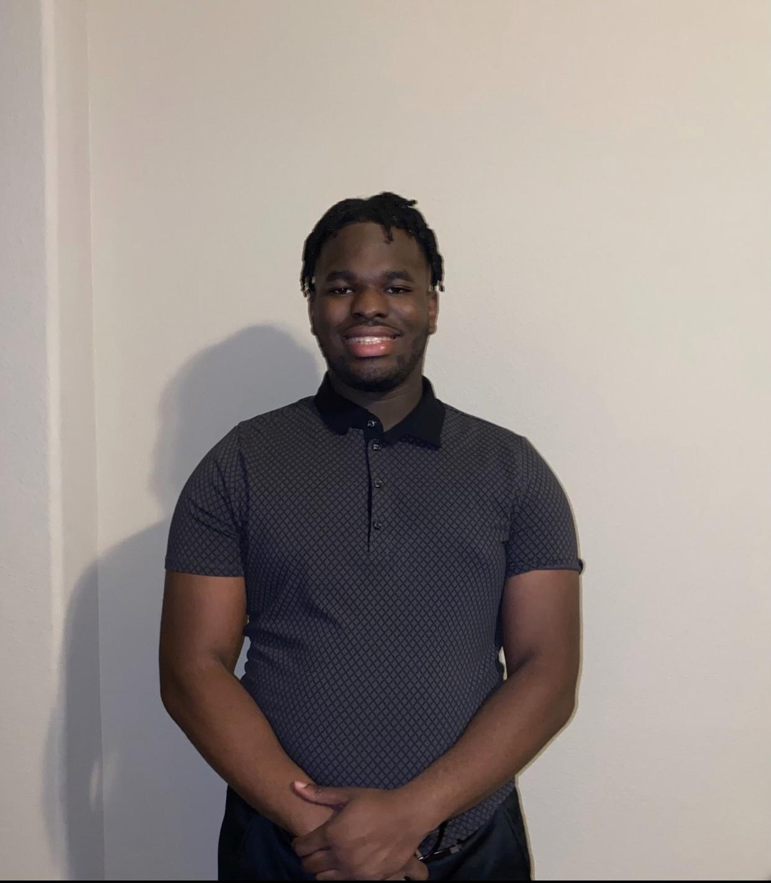

Sheree Adrian Patrick Kharmalina
Introducing the Team
Fullstack Java Developer
https://github.com/Sheree1986
Fullstack Java Developer
https://github.com/adrianbaltag
Fullstack Java Developer
https://github.com/Patrickb001
Fullstack Java Developer
https://github.com/Kharmalina

Slide 3
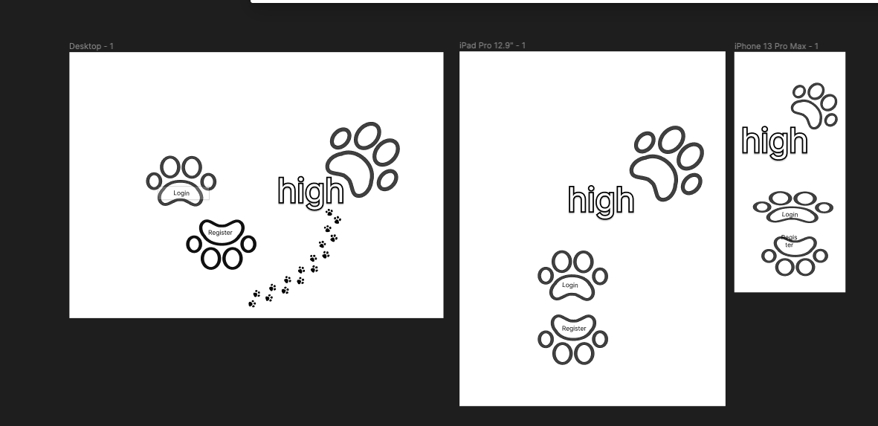
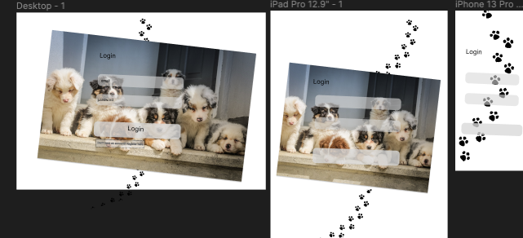
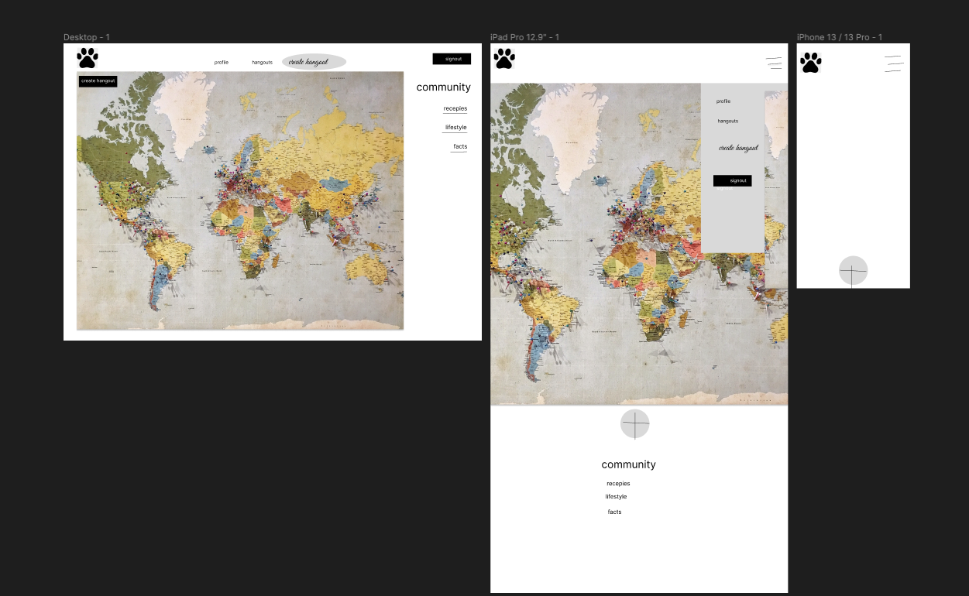
Wireframe

Slide 4
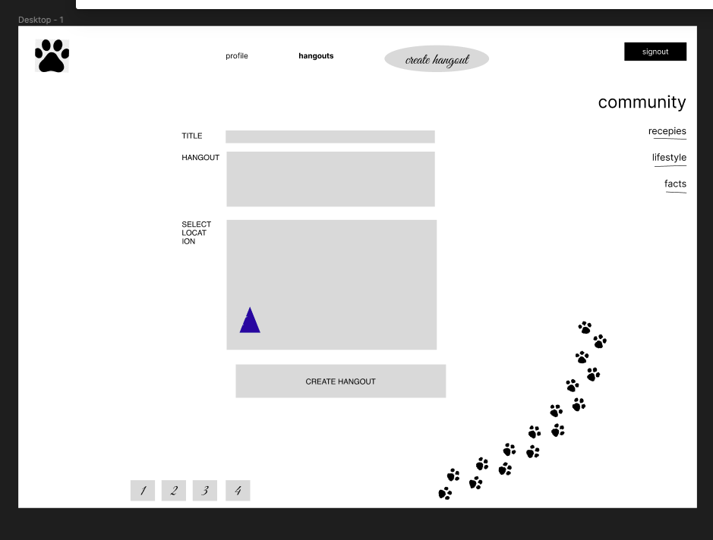
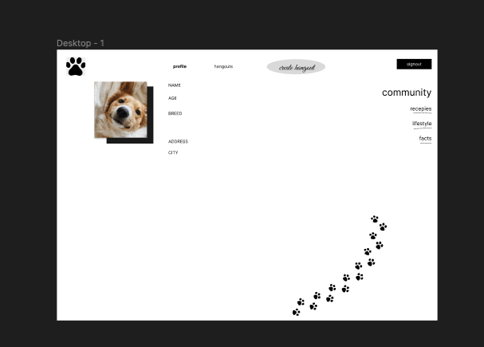
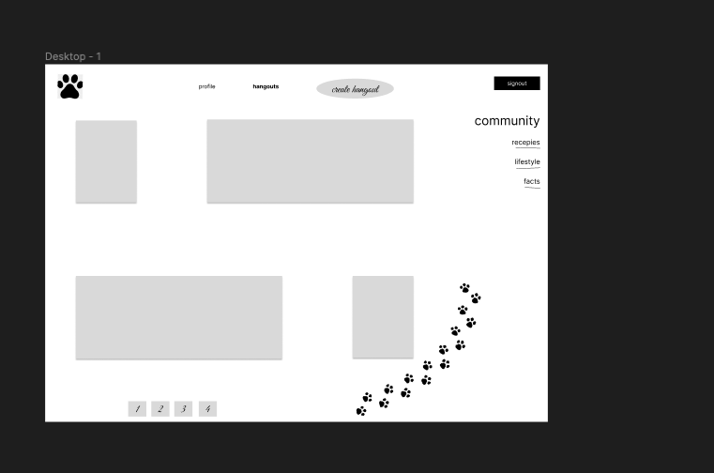
Wireframe cont.
https://www.figma.com/file/2x5QSqglNYAecN0HyDy3vu/high-paw?type=design&node-id=0-1

Slide 5
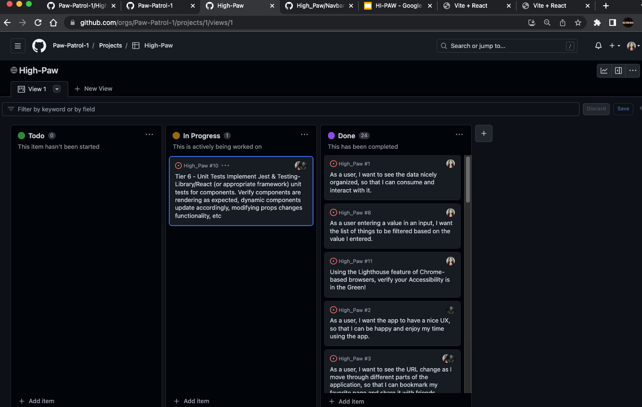
Kanban Board - PM Planning

Slide 6
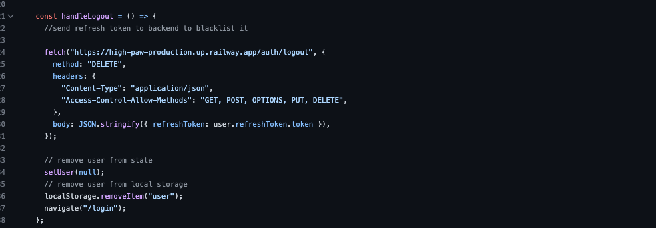
Peaks and Pits
Peak - Learnt to use an array of new stacks:
Tailwind CSS
Redis
Refresh Tokens
Link to deploymlent - https://high-paw-ugau.onrender.com/
Pit - Logging out and deleting Refresh Token.
Adrian 4 days. Sheree 3 Days. Patrick 2 hours. Laurie and Elvis 45 mins.

Slide 7
Backend Tools
express
jsonwebtoken
@hapi/joi
bcrypt
mongoose

Slide 8
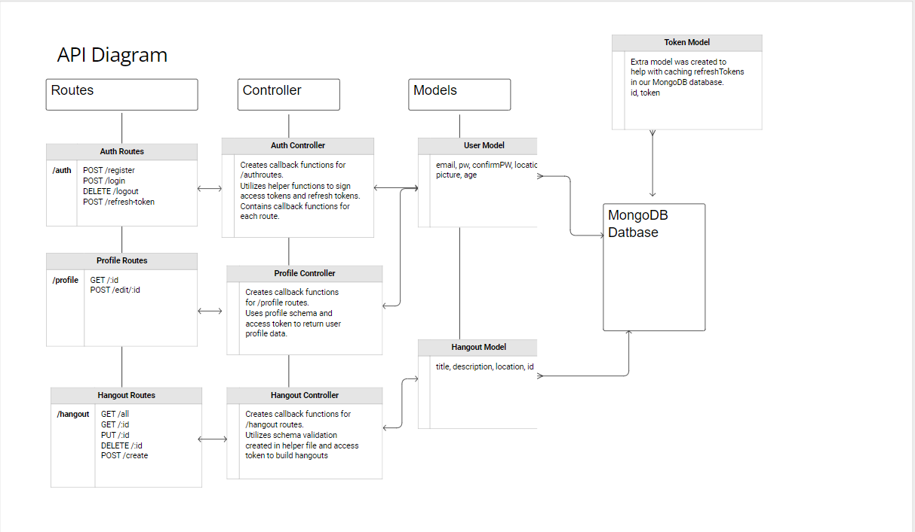

Slide 9
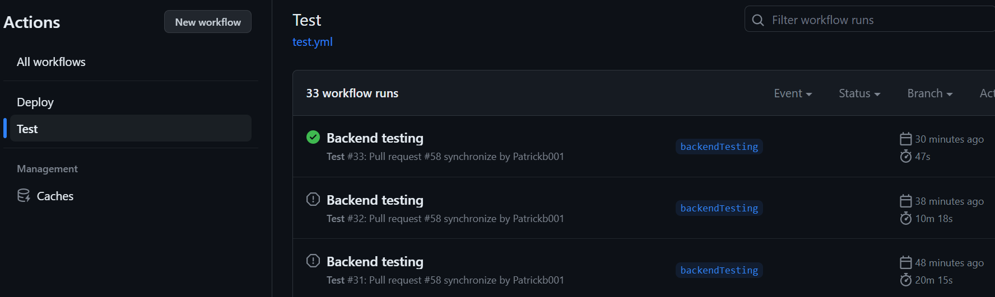
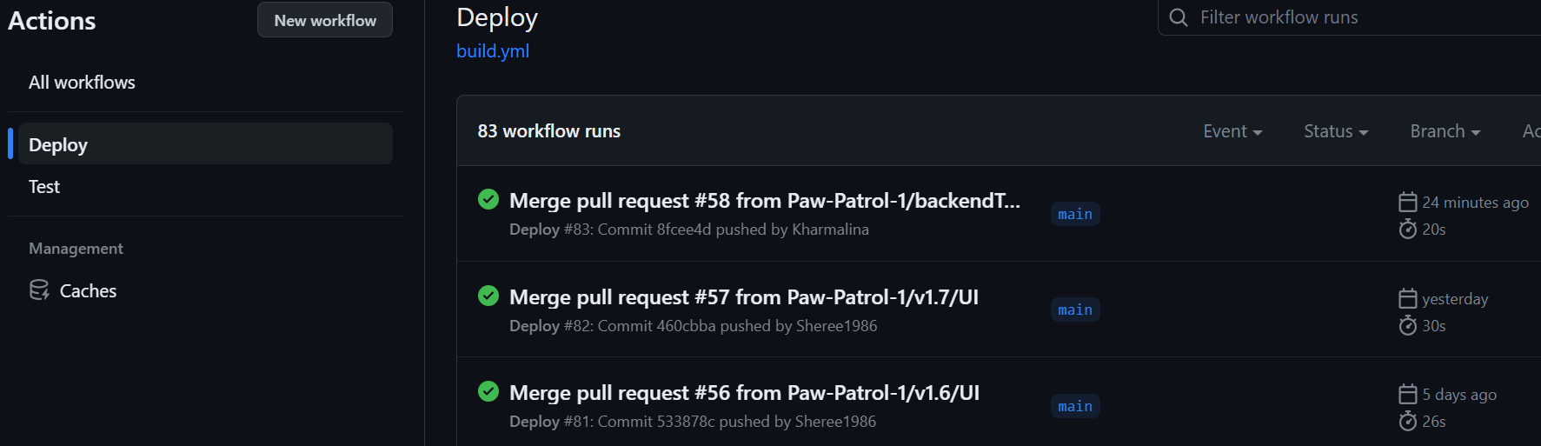
CI & CD

Slide 10
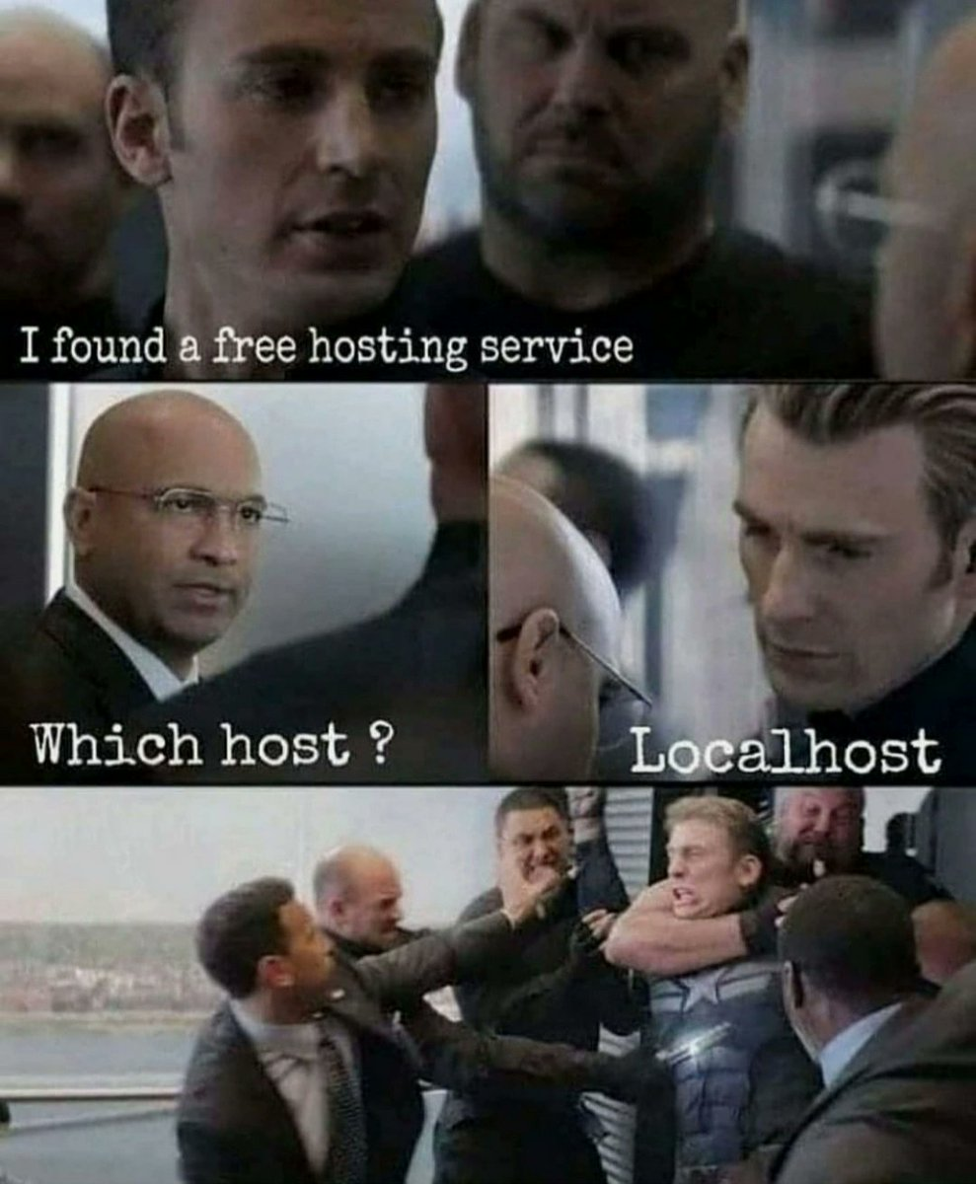


Deployment

Slide 11


